Slide 1
Assignment 4
6354 Xiaoyan Zhang

Slide 2
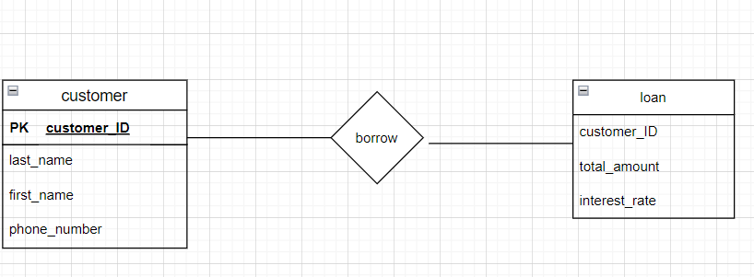
Weak entity is any entity that requires a strong entity to exist. Weak entity is dependent on another. Strong entity is any entity that can exist independently from other entities eg. A customer can have many loans. A loan requires a customer.

Slide 3
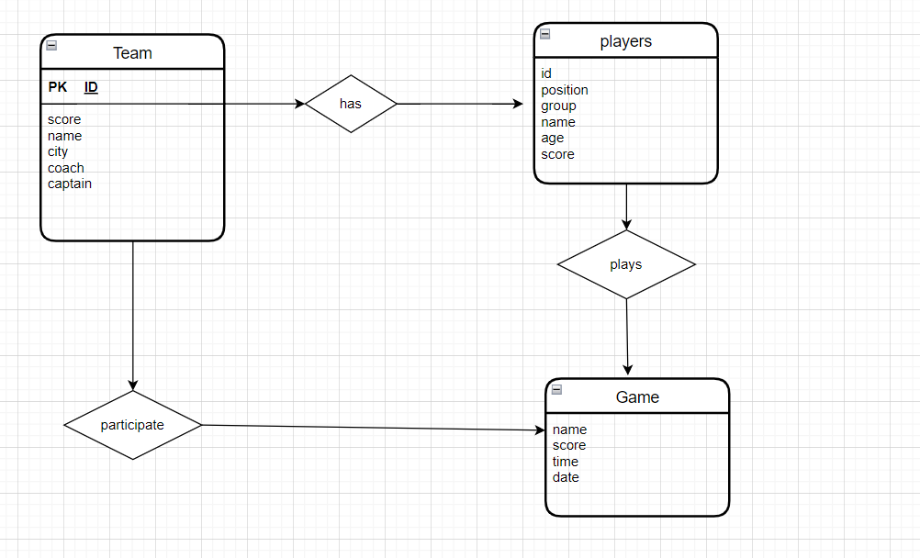

Slide 4
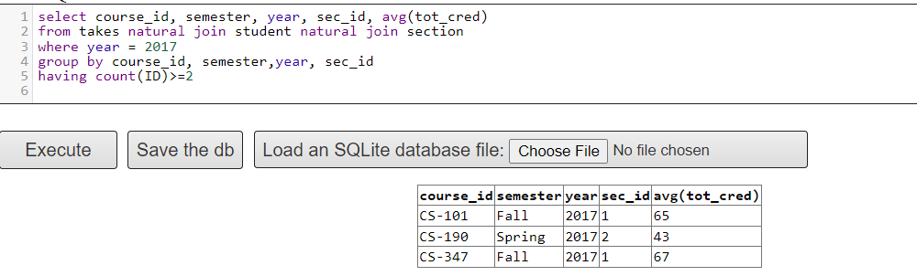
3.(a.i)
3.(a.ii)

Slide 5
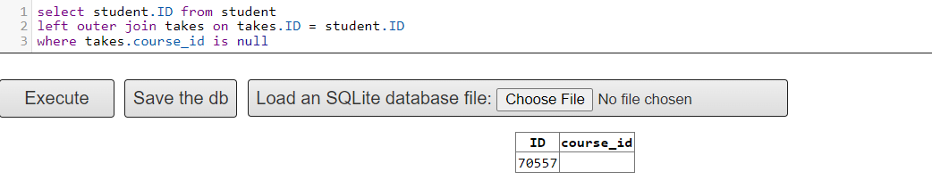
3.(b)

